Slide 1



Computer Networks
Prepared & Presented by: Mirlan Nurbekov, Lecturer
Office hours: Friday 9:00–17:00
AlaToo IT & Business College
Fall 2025

Slide 2
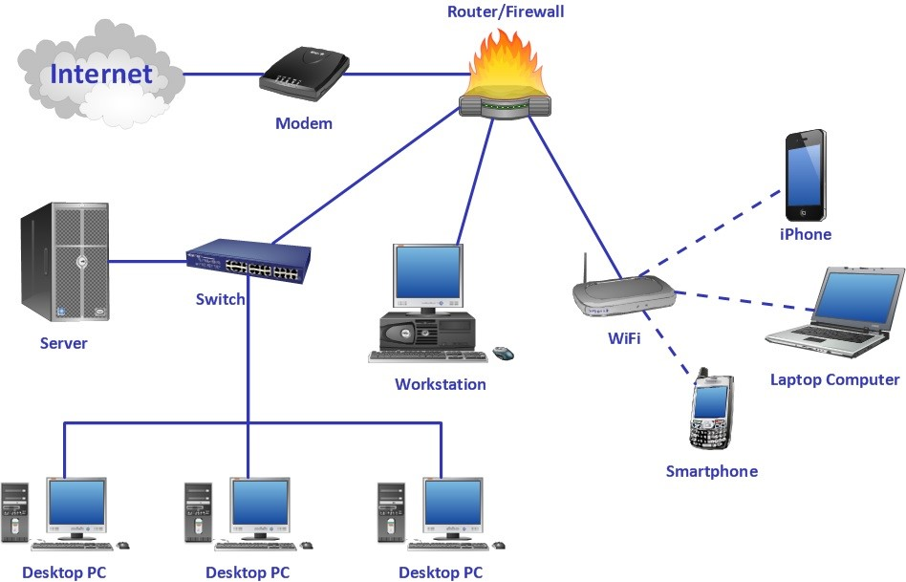
Computer network
A computer network is a collection of interconnected devices—like computers, servers, and printers—that can communicate and share resources with one another.

Slide 3
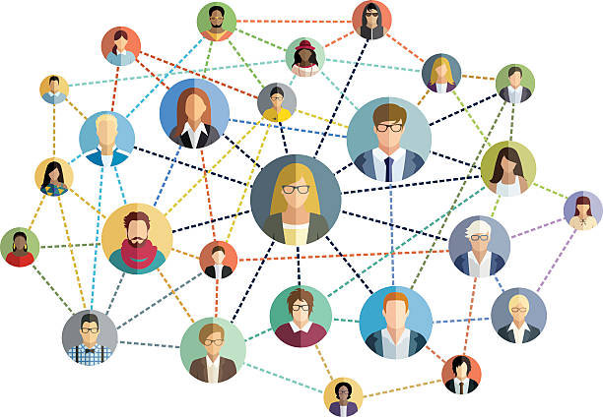

Network models

Slide 4
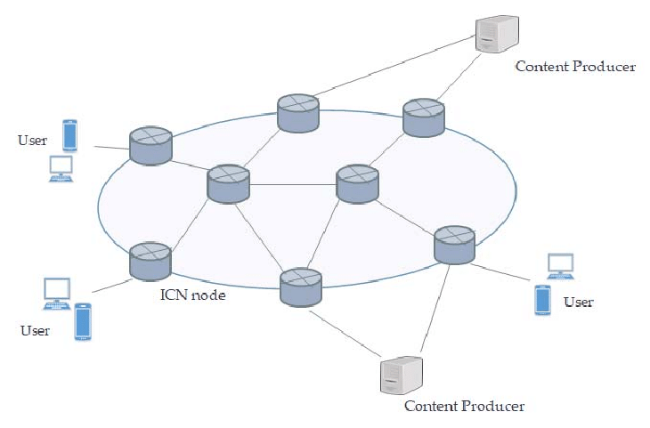
What is a network model?

Slide 5
What is a network model?
A network model is a conceptual framework used to describe the function, structure, and operation of a computer network. It breaks down the complex process of data communication into a set of distinct, manageable, and interconnected layers. Each layer performs a specific set of tasks, and collectively, they ensure that data can be successfully exchanged between different devices and applications, regardless of the underlying technology.

Slide 6




Why do we need a network model?

Slide 7
Why do we need a network model?
Standardization: It provides a universal language and set of rules (protocols) that allow products from different vendors (e.g., Cisco routers, Windows PCs, Apple phones) to communicate seamlessly.
Modularity and simplification: By dividing communication into layers, engineers can focus on one specific function (like routing at Layer 3) without worrying about the specifics of another layer (like physical cabling at Layer 1).
Troubleshooting: When a network problem occurs, the layered model allows technicians to isolate the issue to a specific layer (e.g., "Is this a Layer 3 routing issue or a Layer 2 switching issue?").

Slide 8
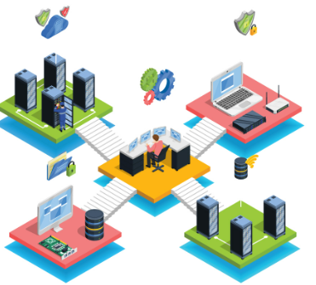
Two most famous and influential network models
OSI
TCP/IP

Slide 9
Two most famous and influential network models
OSI (Open Systems Interconnection) Model: A 7-layer theoretical reference model used primarily for teaching and understanding how different networking concepts relate to each other.
TCP/IP (Transmission Control Protocol/Internet Protocol) Model: The practical, 4/5-layer model that forms the basis for the entire internet and all real-world networking today.

Slide 10
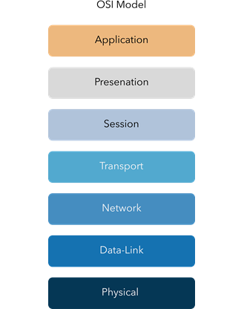
The OSI model layers

Slide 11
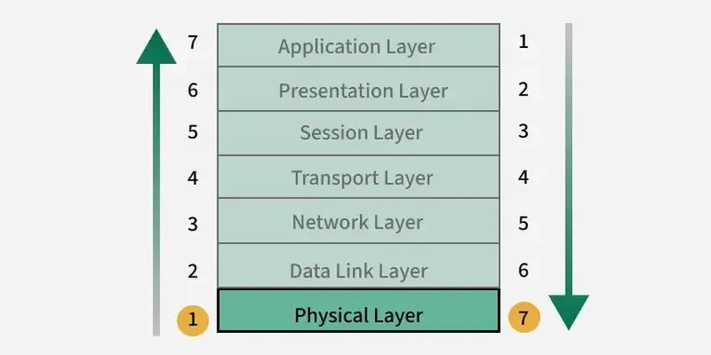

Slide 12
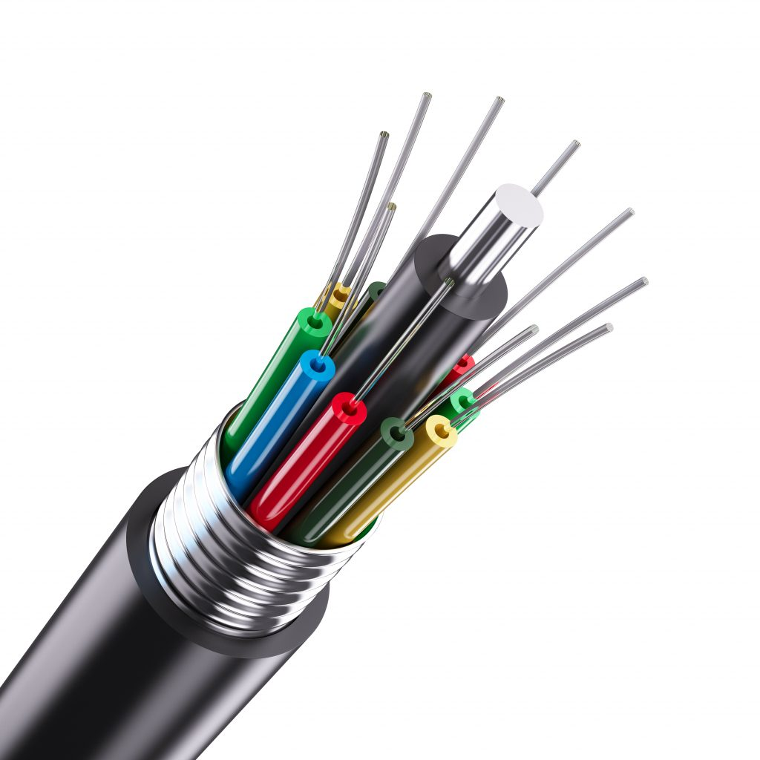
1 – Physical layer
Deals with the physical transmission of data.
Example: Fiber optic cables that literally carry light from point A to point B.

Slide 13
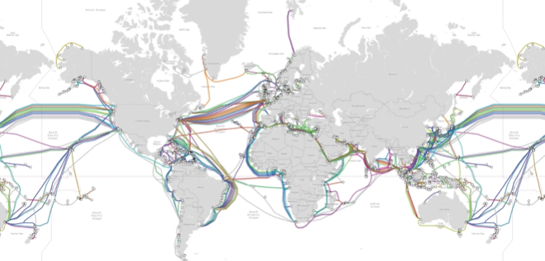
1 – Physical layer

Slide 14
3 – Network layer
Responsible for sending data in the form of packets.
Uses the Internet Protocol (IP): every device has its own IP address to identify it.
A packet is a unit of data that includes both the content and information about the sender and receiver.

Slide 15
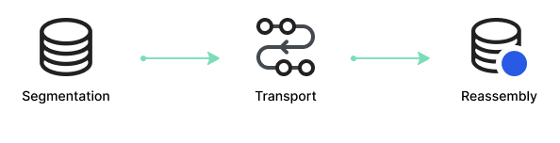
4 – Transport layer
Ensures reliable end-to-end delivery of data.
Uses Transmission Control Protocol (TCP) to segment data into smaller pieces and reassemble them in the correct order.
Also supports UDP for faster but less reliable communication.

Slide 16

5 – Session layer
Manages and controls the connection (session) between two computers.
Handles authentication and authorization to determine if a user can access server data.
Example: A Zoom call maintaining a session between participants.

Slide 17

6 – Presentation layer
Acts as a translator between application data and network format.
Handles encoding, encryption, and compression.
Example: Converting a JPEG image into a standard format readable by applications.

Slide 18
7 – Application layer
Provides services directly to the end user or applications.
Examples:
HTTP/HTTPS → Web browsing
SMTP → Email
FTP → File transfer
End results: pixels on a screen, sounds from a speaker, etc.

Slide 19

7 – Application layer

Slide 20
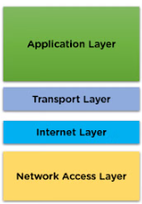
TCP/IP model layers

Slide 21

1 – Application layer
Provides services for applications to communicate over the network
Combines OSI’s Application, Presentation, and Session layers
Protocol examples: HTTP, HTTPS, FTP, DNS, SMTP
Handles data formatting, encryption, and user interface

Slide 22
2 – Transport layer
Ensures data is delivered reliably or quickly
Protocols:
TCP → reliable, connection-oriented
UDP → fast, connectionless
Responsibilities: segmentation, flow control, port addressing

Slide 23
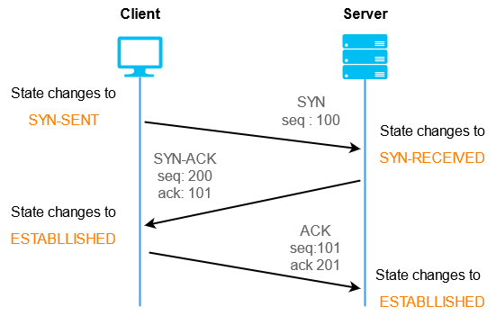
2 – Transport layer

Slide 24
3 – Internet layer
Routes packets between networks and devices
Responsible for addressing and logical delivery
Protocol examples: IP (IPv4, IPv6), ICMP, ARP
Ensures data reaches the correct destination across multiple networks

Slide 25
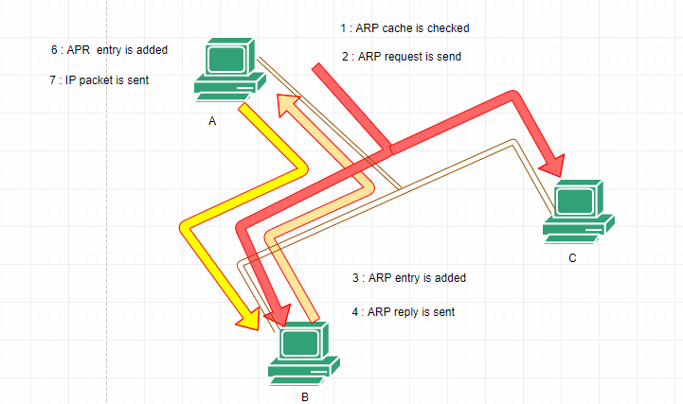
3 – Internet layer

Slide 26
4 – Network access (Link) layer
Handles physical transmission of data over media
Combines OSI’s Data Link + Physical layers
Protocols: Ethernet, Wi-Fi
Devices: NICs, switches, hubs, cables
Converts packets into frames and bits for actual transmission

Slide 27
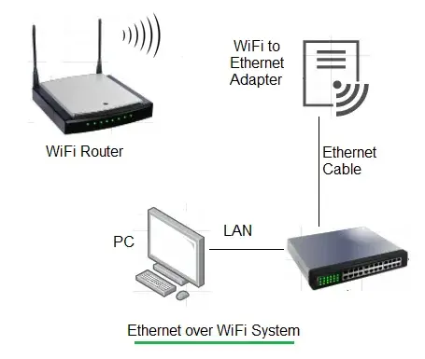
4 – Network access (Link) layer

Slide 28
